Slide 1


A
project based on
RESUME
CLASSIFICATION

Slide 2


Group Number - 04
Guider – Adhvaith Sir
TEAM MEMBERS :
Amrutwad Anuja Pandurang
Ashwinikumar Mukteshwar Singh
Mandar Santosh Bhere
Navgire Kirankumar Prakash
Omkar Satish Kumbhar
Rushikesh Panditrao Dhumal
Saswatee Das

Slide 3


What is natural language processing (NLP) in data science?
Natural Language Processing or NLP in data science is the automatic manipulation of natural languages, like speech and text, by using software that helps computers observe, analyze, understand, and derive valuable meaning from natural or human-spoken languages.
What is NLP project ?
An NLP project's ultimate objective is to develop a model or system that can handle natural language data in a way that is precise, effective, and practical for a given job or application. This may involve enhancing chatbot functionality, speech recognition, language translation, and a variety of other uses.

Slide 4


STEPS
Importing and Cleaning data
EDA
Data visualization
Creating and Training the Model
Model Evaluation
Model Deployment

Slide 5
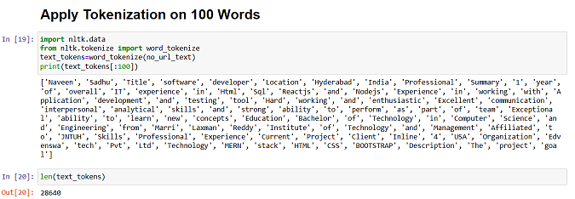
TOKENIZATION in NLP:
Tokenization breaks text into smaller parts for easier machine analysis, helping machines understand human language.

Slide 6
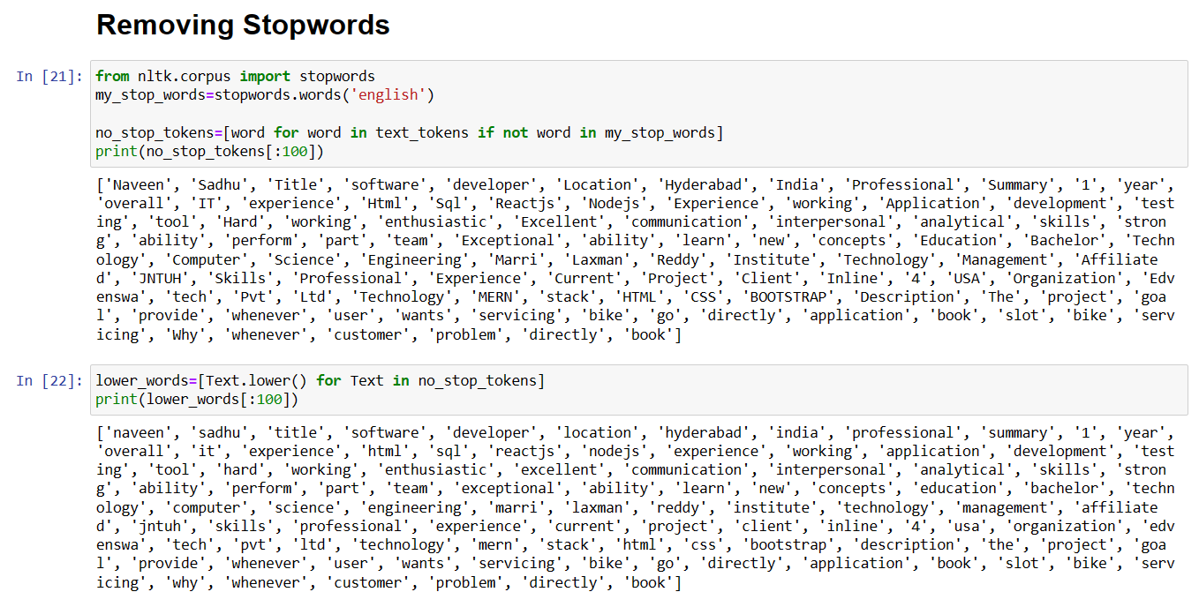
REMOVING STOPWORDS :-
To remove stop words, create a list of words to remove, tokenize the text data, check each token against the stop word list, and can stop words from the text data.

Slide 7
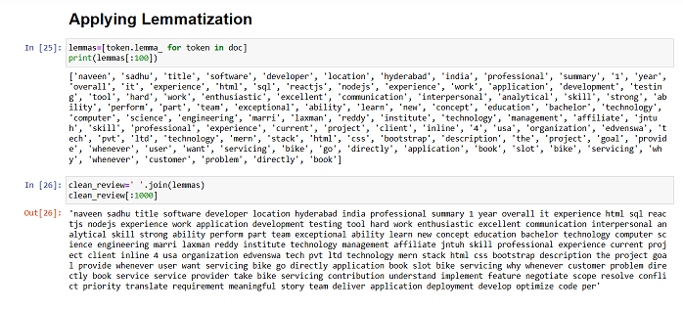
LEMATIZATION in NLP :-
Lemmatization, in Natural Language Processing (NLP), is a linguistic process used to reduce words to their base or canonical form, known as the lemma.
This technique helps systems understand the complex meanings of words in various settings, leading to more accurate information retrieval and analysis.

Slide 8
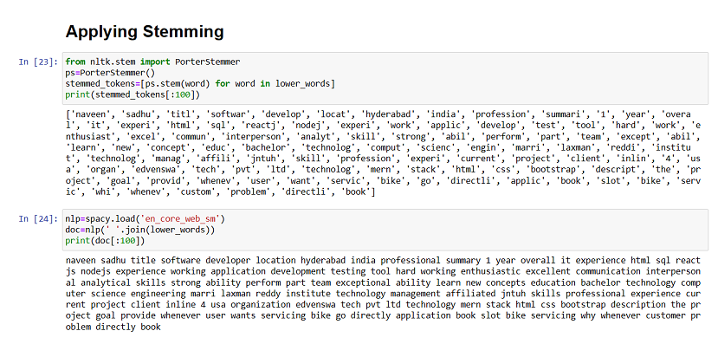
STEMMING in NLP :-
In natural language processing (NLP), stemming is a text normalization technique that involves reducing words to their base or root form by removing suffixes.
The goal of stemming is to simplify words to their common linguistic root, so variations of a word, such as plurals or verb conjugations, are treated as the same word.

Slide 9

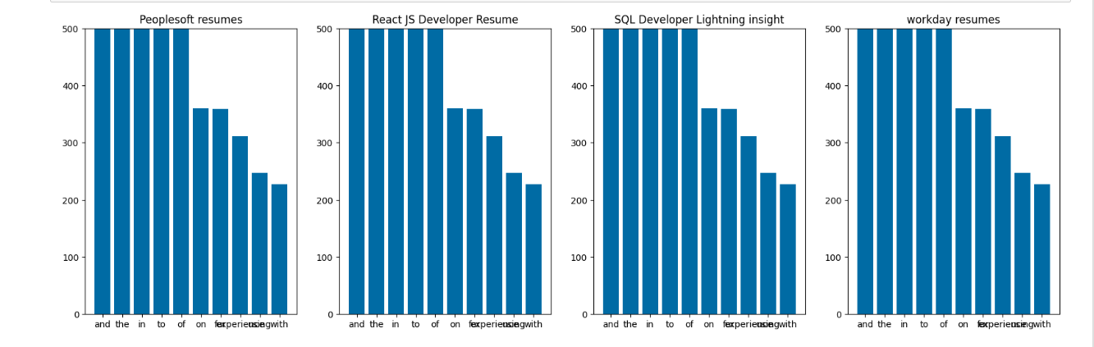
Count Vectorization in NLP :-
Machines cannot understand characters and words. So when dealing with text data we need to represent it in numbers to be understood by the machine. Count vectorization is a method to convert text to numerical data.

Slide 10
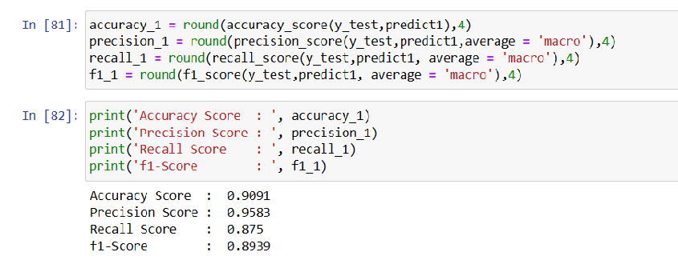
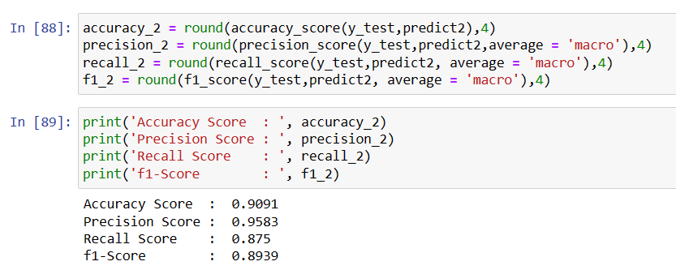
MODELLING :-
Logistic Regression
Support Vector
Machine Classifier(SVC)

Slide 11
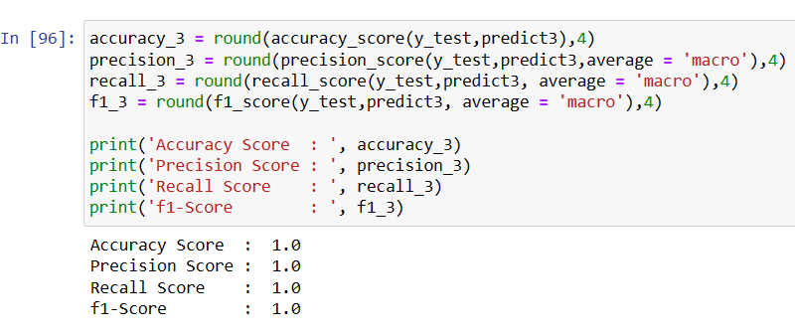
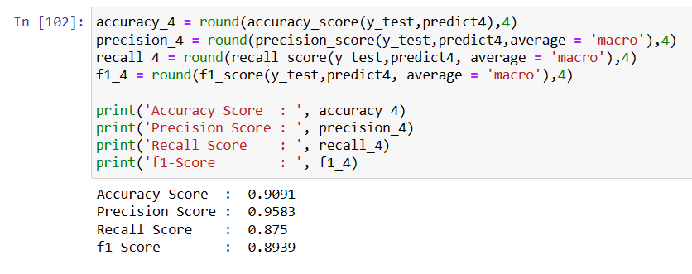
Random Forest Classifier
Naive-Bayes Classifier

Slide 12
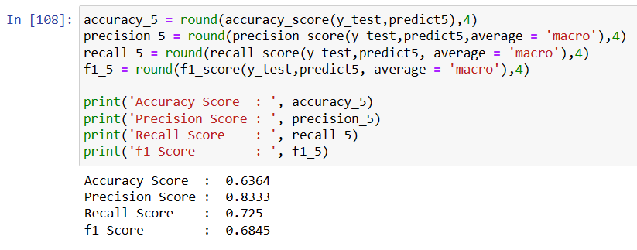

Decision Tree Classifier
AdaBoost Classifier

Slide 13
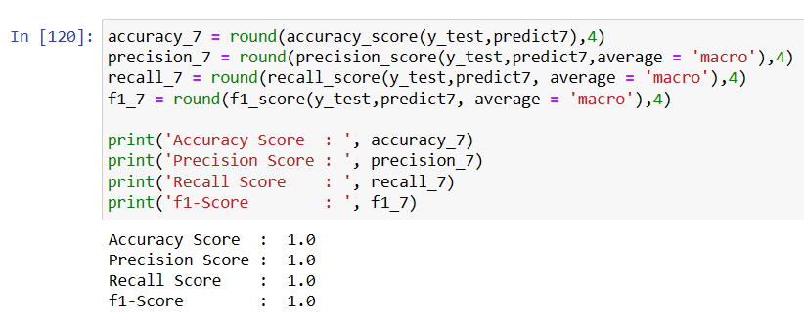
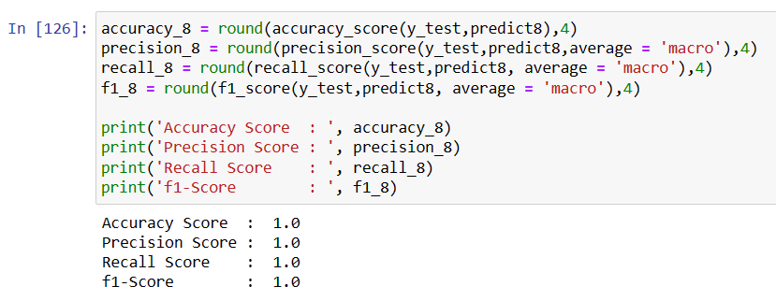
Gradient
Boosting Classifier
XGBoost Classifier

Slide 14
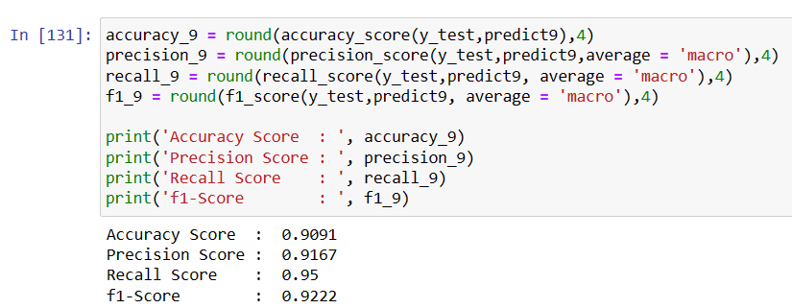
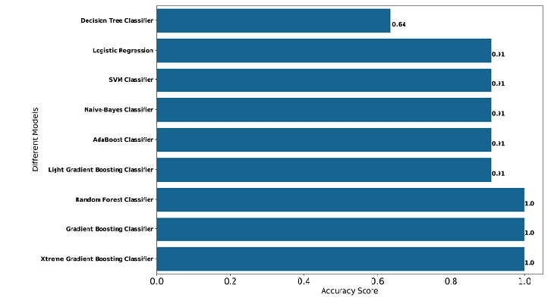
LGBM-Boosting Classifier

Slide 15

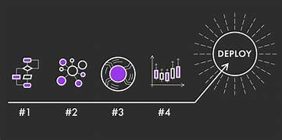
Model Deployment
What is MODEL DEPLOYMENT
Deploying a machine learning model, also known as model deployment, simply means integrating a machine learning model into an existing production environment where it can take in an input and return an output. The purpose of deploying your model is so that you can make the prediction from a trained machine learning model available to others, whether that be users, management or other systems.
Model deployment is closely related to machine learning systems architecture, which refers to the arrangement and interactions of software components within a system to achieve a predefined goal.

Slide 16
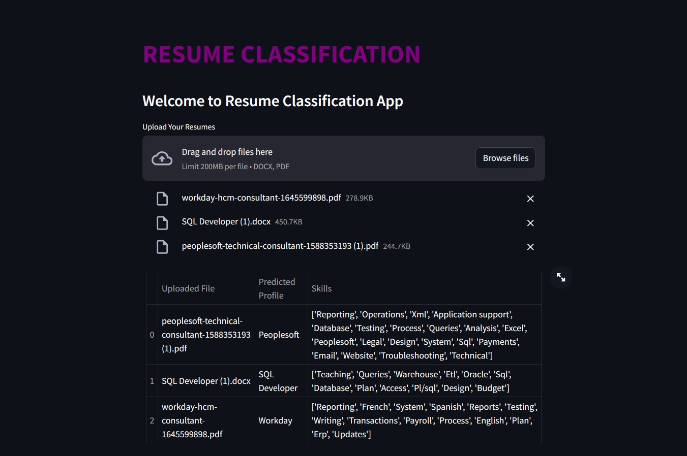

Slide 17
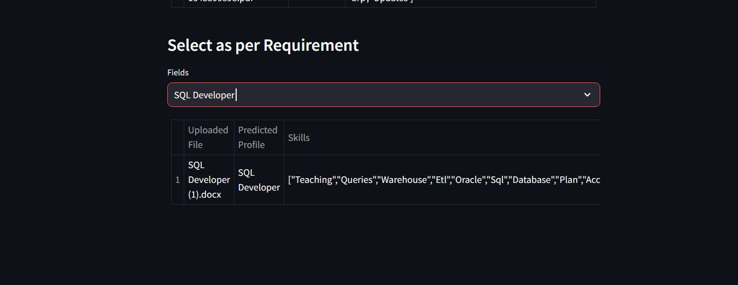
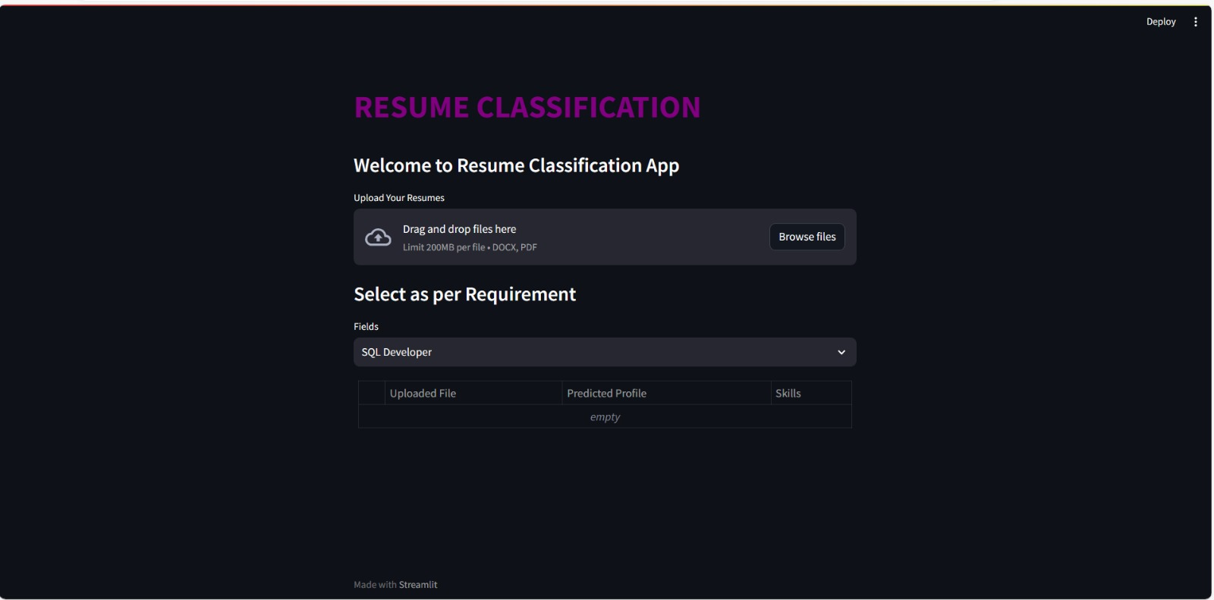

Slide 18

THANK YOU

